Slide 1
Discussion Module:
Review the briefest amount of material related to DSE and DSE Core, so that we may start to understand the Why and What of DSE Search.
(One) DSE Object Hierarchy
Brewer’s CAP Theorem, Consistency Level (CL)
Four Primary functional Areas to DSE
Index (types/options) in DSE Core
DSE Search Prerequisites
Notes:
The goal of this Discussion Module is to review the briefest amount of material related to DSE and DSE Core, so that we may start to understand the Why and What of DSE Search.
Meeting the prerequisites, none of the information in this Discussion Module should be terribly new.

Slide 2
Discussion Lab:
DSE Object Hierarchy
Refrigerator Magnets - Match the terms on the right with the boxes on the left
Notes:
On the next page we enter a Discussion Lab.

Slide 3
Discussion Lab: (One) DSE Object Hierarchy
A:
Replication Strategy
E == G + H
Keyspace
E:
Clustering Column
F:
Node (host)
B:
Table
Cluster
C:
Primary Key
Replication Factor
E:
D:
Rack
F:
Data center
Partitioning Key
J == K + M
And answer the questions on the Notes Page-
Notes:
Refrigerator magnets Discussion Lab: detailing (one) DSE object hierarchy-
Match the terms on the right with the lettered boxes on the left.
In order to have a minimally functioning DSE cluster (the cluster is at least booted), which of the terms/objects (A-M) are required, which are optional ?
“E” has one of four (specific properties), two of which are internal/system-use only. Name the two (specific properties) available for normal (end user) use ?
Above, extra credit: name the two internal/system-use (specific properties).
In order to deliver it’s intended functionality, one of the (specific properties) requires multiple letter B’s. Name the (specific property), and explain-
Given any two letters, which top level letter (object) must be wholly contained within another letter (object) ?
Similarly; which letter (objects) can be a member of multiple letter (objects) ?

Slide 4
End of Discussion Lab:
Notes:
End of Discussion Lab-

Slide 5
Wikiepdia.com: Brewer’s CAP Theorem
Generally, choose two:
“Consistency - Every read receives the most recent write or an error
“Availability - Every request receives a (non-error) response – without guarantee that it contains the most recent write
“Partition - The system continues to operate despite an arbitrary number of messages being dropped (or delayed) by the network between nodes
“CAP is frequently misunderstood as if one has to choose to abandon one of the three guarantees at all times. In fact, the choice is really between consistency and availability only when a network partition or failure happens; at all other times, no trade-off has to be made.
Source: https://en.wikipedia.org/wiki/CAP_theorem
Notes:
From Brewer’s CAP theorem, network partition (CAP, P: partition) fault tolerance.
Assume two data centers, and a network fault such that the two data centers can not currently communicate; USA and Germany, the WAN is down.
If the same data row is written to by two users in two different data centers, DSE Core will automatically merge the two disparate rows and create a best surviving (most accurate) copy of the data when the network partition issue is restored.
From Brewer’s CAP theorem; writes always succeed.
The behavior that the user routine receives is tunable, statement by statement. If you need a write and confirm on every node, you can have that (assuming the network is up). This level of (confirmation) however, will slow performance; generally expect 45-75 or more milliseconds just to network ping between the USA and Germany.

Slide 6




CAP: Data Centers and Consistency Level (CL)
Data Center 1
DB
Data Center 2
DB
Network
Interruption
DB
DB
DB
DB
DB
DB
App
App
Clients
Clients
Notes:
While Core is always on, (Search, Analytics and/or Graph) must be on/booted/available on a data center wide basis. That is to say: you should not boot (Search, Analytics, Graph) on a subset of nodes to a data center.
Repeat: Detail/defend at least two reasons why we might have multiple data centers-
--
Consistency Level (CL) may be set statement by statement, and may be different for reads and writes.
Define quorum -- quorum = (sum_of_replication_factors / 2) + 1
What settings yield “strong consistency” ? -- (nodes_written + nodes_read) > replication_factor
Various CL settings: (discuss each)
ALL
ONE, TWO, THREE
LWT only; SERIAL, LOCAL_SERIAL
QUORUM
LOCAL_QUORUM
LOCAL_ONE
EACH_QUORUM

Slide 7
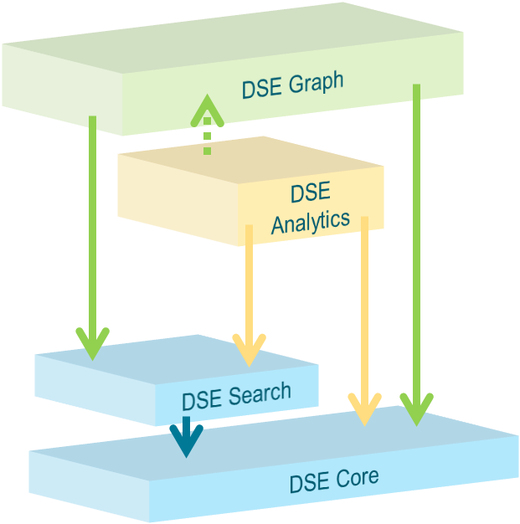
The 4 Primary Functional Areas to DSE
Only 2 of the 4 primary functional areas to DSE provide indexing technology
DSE Core, primarily hash
DSE Search, Tf-Idf (bitmap)
All 4 primary functional areas provide query processing
Differentiated query predicates, or functionality
Specific performance abilities
Query processing
Index and query processing
Notes:
The four primary functional areas to DSE are listed in the graphic above: DSE Core (Core), DSE Search (Search), DSE Analytics (Analytics), DSE Graph (Graph).
Core is always on; it is impossible to operate any node within a DSE cluster without Core.
The remaining 3 primary functional areas are either on or not on (on/booted/available, or not). If Search and a Search index is available (and necessary), Analytics or Graph may use said index. Generally, if Analytics or Graph would benefit from a Search index, and none is available, the Analytics or Graph routine will still function, albeit more slowly.
While Core is always on, (Search, Analytics and/or Graph) must be on/booted/available on a data center wide basis. That is to say: you should not boot (Search, Analytics, Graph) on a subset of nodes to a data center.
--
We discuss the index and query capabilities of at least Core and Search on the pages that follow.

Slide 8
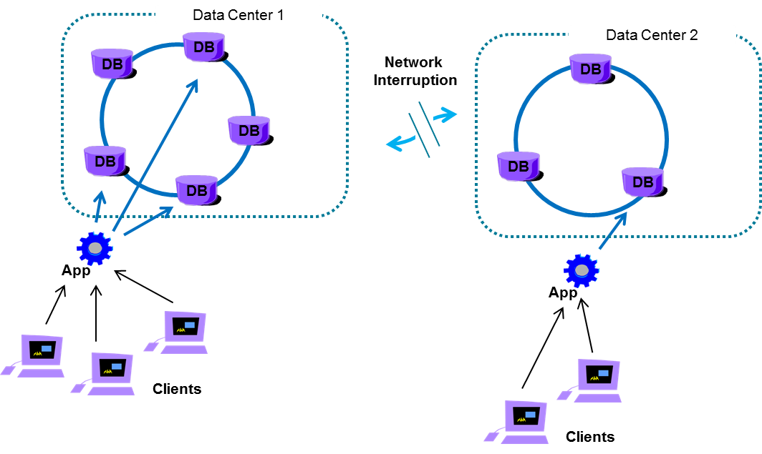
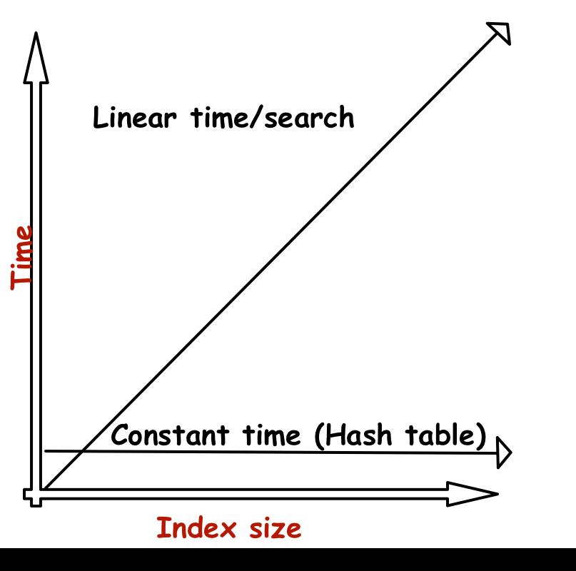
Why DSE Core: 2 of (M) Value Propositions
Notes:
Related to just DSE Core, two of the Core’s value propositions to users include:
From Brewer’s CAP theorem, network partition (CAP, P: partition) fault tolerance.
Assume two data centers, and a network fault such that the two data centers can not currently communicate; USA and Germany, the WAN is down.
If the same data row is written to by two users in two different data centers, DSE Core will automatically merge the two disparate rows and create a best surviving (most accurate) copy of the data when the network partition issue is restored.
From Brewer’s CAP theorem; writes always succeed.
The behavior that the user routine receives is tunable, statement by statement. If you need a write and confirm on every node, you can have that (assuming the network is up). This level of (confirmation) however, will slow performance; generally expect 45-75 or more milliseconds just to network ping between the USA and Germany.
And time constant lookups. More below.
The central technology to time constant lookups is the hash index. B-Tree+ is the index type common (core) to most relational database systems (RDBMS). A compare/contrast of hash and B-Tree+ includes:
B-Tree+ excels at volatile data. Hash excels at (nearly requires) static data. (RDBMS: update in place. DSE: static/append-only, and compact.)
The root and first (branch) levels of a B-Tree+ are well cached (memory), but does not scale linearly. Hash does scale linearly.
Single node databases (indexes) are better able to skip-scan within the index. E.g., WHERE last_name > “Wilson” and first_name > “Thomas”.
In multi-node databases (horizontal scalability), we greatly prefer to localize queries to a single node; an equality on the whole of the (hash) index partitioning key also identifies the database server node.
Queries that must fan-out to multiple nodes (are not able to localize to a single node via the requested data’s key value) are titled, scatter/gather queries.
Ps: the linear time search in the graphic above (the 45 degree line), is a sequential scan.
Ps: a B-Tree+ index retrieval will offer some curve in the graph above before failing to scale.
Right image source: http://karlheinzniebuhr.github.io/en/2016/01/28/how-does-a-hash-table-work/

Slide 9
Wikipedia.com: B-Tree+ Index
“In computer science, a B-tree is a self-balancing tree data structure that keeps data sorted and allows searches, sequential access, insertions, and deletions in logarithmic time.
“An algorithm is said to take logarithmic time if T(n) = O(log n). ... AnO(log n) algorithm is considered highly efficient, as the ratio of the number of operations to the size of the input decreases, and tends to zero when n increases.
Source: https://en.wikipedia.org/wiki/B-tree
Source: https://en.wikipedia.org/wiki/Time_complexity#Logarithmic_time
Notes:
It is generally well understood that B-Tree+ indexes do not scale linearly.
DSE Core is based on two seminal industry white papers:
Google BigTable, https://static.googleusercontent.com/media/research.google.com /en//archive/bigtable-osdi06.pdf
Amazon Dynamo, http://www.allthingsdistributed.com/files/amazon-dynamo-sosp20 07.pdf
From BigTable, we get file (table) access methods, and more. From Dynamo, we get clustering, and more.
It’s worth noting that BigTable does not make use of B-Trees, and instead uses hash.

Slide 10
Wikipedia.com: (Hash Index, time constant)
“In a well-dimensioned hash table, the average cost (number of instructions) for each lookup is independent of the number of elements stored in the table.
Many hash table designs also allow arbitrary insertions and deletions of key-value pairs, at (amortized[2]) constant average cost per operation.
Source: https://en.wikipedia.org/wiki/Hash_table
Notes:
Hash indexes, when well implemented (written and used), can scale linearly.
However, hash indexes have limits in their application-
If you are not using an equality on the whole of the partitioning key (primary key), you often sequentially scan all/most of the hash index structure.
If this is a multi-node table, you begin spanning nodes (scatter/gather).

Slide 11
Discussion Lab:
DSE Core/(hash)
Which Query Predicates are Supported ,
Which Queries are Core/Search?
Design
Notes:
On the next page we enter a Discussion Lab.

Slide 12


Discussion Lab: Just Core, Which Query Predicates are Supported
CREATE TABLE t1 ...
(
col1 TEXT,
col2 TEXT, ...
PRIMARY KEY ((col1, col2)
col3, col4)
) WITH CLUSTERING ORDER BY
(col3 DESC, col4 ASC);
SELECT * WHERE ...
col? =
col? >
AND ... / OR ...
ORDER BY
col? ;
col?, col? ;
GROUP BY
col?, col? ;
Notes:
Define/review the definition of the primary key:
Partition key, one or more columns
Clustering key, zero or more columns
Concatenation of both defines the primary key.
Different from an RDBMS, the DSE primary key also affect data location/placement (to a node).
Equality on the whole of the partitioning key, else it’s a scatter/gather.
ALLOW FILTERING, not time constant; likely to fail based on safety settings, not for production.
Discuss many/all of the DSE Core supported queries-

Slide 13
Discussion Lab: Which are Core/Search Queries
SELECT * FROM t1
WHERE col1 = 10;
WHERE col1 LIKE ‘Chuck’;
WHERE col1 = 10 AND col2 = 20;
WHERE col1 = 10 AND col2 = 20 and col3 > 30;
WHERE col1 = 10 and col2 = 20 ORDER BY col3;
WHERE solr_query =
'{ "q" : "(name:D* OR name:DAVE~1^8)
AND gender:M AND century:2000" }';
CREATE TABLE t1 ... ?? ;
Notes:
For each of the (n) queries above:
Is this a DSE Core or DSE Search query ?
What Core primary key would you need ?

Slide 14
End of Discussion Lab:
Notes:
End of Discussion Lab-

Slide 15

Other DSE Core (Indexes)
Materialized Views
Secondary Indexes
(Custom Indexes)
SASI Indexes
(DSE Query Tables)
Copyright: Village Roadshow Pictures
Notes:
It is the hash index that gives DSE Core it’s time constant lookup performance.
But, there are other indexes and modeling options available inside Core.

Slide 16

DSE Core: Materialized Views
CREATE MATERIALIZED VIEW t1_v1
AS
SELECT col1, ... , col8
FROM t1
WHERE
col1 IS NOT NULL AND col2 IS NOT NULL
AND col7 IS NOT NULL
PRIMARY KEY (col1, col2, col7);
OR, PRIMARY KEY ((col8), col2, col1); OR, OR ..
CREATE TABLE t1 ...
PRIMARY KEY
((col1, col2)) );
Notes:
DSE (Core) materialized views allow you to reshuffle or extend by one column the full primary key (partitioning key and clustering key both). E.g., you can add zero or one column to support additional equalities, ranges, or sorts. You can also resort the column order of the primary key columns.
Materialized views exist as DSE tables, just like the single DSE table they are derived from. As the source table is updated, deleted and inserted into, the contents of the single or set of materialized views are updated asynchronously (in a non-blocking manner). Materialized views must always access a source/base table, and may not access another materialized view.
--
A full syntax example is pasted below:
CREATE TABLE ks_15.t1
(
col1 TEXT,
col2 TEXT,
col3 TEXT,
col4 TEXT,
col5 TEXT,
col6 TEXT,
col7 TEXT,
col8 TEXT,
PRIMARY KEY ((col1, col2));
CREATE MATERIALIZED VIEW t1_v1 AS
SELECT col1, col2, col3, col4, col5, col6, col7, col8
FROM t1
WHERE
col1 IS NOT NULL AND col2 IS NOT NULL AND
col7 IS NOT NULL
PRIMARY KEY (col1, col2, col7);

Slide 17

Materialized Views: You may not
CREATE MATERIALIZED VIEW t1_v2 AS
SELECT col1, ... , col8
FROM t1
WHERE
col1 IS NOT NULL AND col2 IS NOT NULL AND
col7 IS NOT NULL AND col5 IS NOT NULL
PRIMARY KEY (col1, col2, col7, col5);
// InvalidRequest: Error from server: code=2200 [Invalid query]
// message="Cannot include more than one non-primary key column
// 'col5' in materialized view primary key"
CREATE TABLE t1 ...
PRIMARY KEY
((col1, col2)) );
Notes:
Error: You can not add multiple columns to the primary key using materialized views.

Slide 18
Materialized Views: You may not
CREATE MATERIALIZED VIEW t1_v2 AS
SELECT col1, ... , col8
FROM t1
WHERE
col1 IS NOT NULL AND col2 IS NOT NULL AND
col7 IS NOT NULL
PRIMARY KEY (col1, col7);
// InvalidRequest: Error from server: code=2200 [Invalid query]
// message="Cannot create Materialized View t1_v2 without
// primary key columns from base t1 (col2)"
CREATE TABLE t1 ..
PRIMARY KEY
((col1, col2)) );
Notes:
Error: And you can not drop columns from the primary key using materialized views.

Slide 19
Materialized Views: You may not
CREATE MATERIALIZED VIEW t2_v1 AS
SELECT col1, ... , col8
FROM t2
WHERE
col1 IS NOT NULL AND col2 IS NOT NULL AND
col3 IS NOT NULL AND col6 IS NOT NULL
PRIMARY KEY (col1, col2, col3, col6);
// InvalidRequest: Error from server: code=2200 [Invalid query]
// message="Cannot create Materialized View t2_v1 without
// primary key columns from base t2 (col4)"
CREATE TABLE t1 ..
PRIMARY KEY
((col1, col2),
col3, col4) );
Notes:
Error: Another example of attempting to drop columns from the primary key using materialized views.

Slide 20

DSE Core: Secondary Indexes
SELECT * FROM T1 WHERE col3 = 'ddd';
SELECT * FROM T1 WHERE col3 = 'ddd‘
AND col1 = ‘ddd’ AND col2 = ‘ddd’;
CREATE TABLE t1 ..
PRIMARY KEY
((col1, col2)) );
CREATE INDEX i2
ON t1 (col3);
Scatter/gather
Node local
Notes:
Secondary indexes are considered well placed/used, when the query predicate includes an equality on the whole of the partitioning key.
If the query predicate does not include an equality on the whole of the partitioning key (primary key), then you will experience a scatter/gather query. Scatter/gather queries are to be avoided in all production systems.

Slide 21
Secondary Indexes: You may not
SELECT * FROM T1 WHERE col3 > 'ddd';
// InvalidRequest: Error from server: code=2200 [Invalid query]
// message="Cannot execute this query as it might involve data
// filtering and thus may have unpredictable performance.
// If you want to execute this query despite the performance
// unpredictability, use ALLOW FILTERING"
Notes:
The CQL SELECT statement above will fail with the displayed error message.

Slide 22
Secondary Indexes: You may not
SELECT * FROM T1 WHERE col3 = 'ddd' ORDER BY col3;
// InvalidRequest: Error from server: code=2200 [Invalid query]
// message="ORDER BY with 2ndary indexes is not supported."
Notes:
The CQL SELECT statement above will fail with the displayed error message.

Slide 23
Secondary Indexes: You may not
CREATE INDEX i3 ON t1 (col5, col6);
// InvalidRequest: Error from server: code=2200 [Invalid query]
// message="Only CUSTOM indexes support multiple columns"
Notes:
The CQL SELECT statement above will fail with the displayed error message.

Slide 24
DSE Core: Two (?) Custom Indexes
CREATE TABLE ks_15.t1 (
col1 text, ...
DESCRIBE TABLE t1;
CREATE CUSTOM INDEX ks_15_t1_solr_query_index
ON ks_15.t1 (solr_query) USING 'com.datastax.bdp.search.solr.Cql3SolrSecondaryIndex';
CREATE CUSTOM INDEX i5 ON ks_15.t1 (col7) USING
'org.apache.cassandra.index.sasi.SASIIndex';
An object titled, “custom index’ displays in a DESCRIBE TABLE as the result of:
CREATE CUSTOM INDEX ...
These are “SASI Indexes”, covered next-
CREATE SEARCH INDEX ...
These are DSE Search indexes
Notes:
A CQL DESCRIBE TABLE may output two (types) of “custom indexes”; SASI indexes, described next, and DSE Search indexes.
SASI indexes are created with the CQL command verb, CREATE CUSTOM INDEX.

Slide 25
DSE Core: (Custom) SASI Indexes
CREATE CUSTOM INDEX i5
ON ks_15.t1 (col7)
USING 'org.apache.cassandra.index.sasi.SASIIndex' ;
// Warnings :
// SASI index was enabled for 'ks_15.t1'. SASI is still
// in beta, take extra caution when using it in
// production.
Beta
Notes:
SASI indexes are considered, “not for production use”, however; everything can be functionally achieved using DSE Search indexes, compared to SASI indexes.

Slide 26
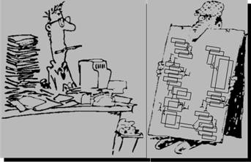
DSE Core: (Query Tables)
SQL/relational-
Data modeled regardless of use
Codd/Date, Third Normal Form
No/few redundant attributes
Limiting cost factor, disk space/capacity
Post-relational/NoSQL-
Data modeled entirely by use
Derived/redundant data for performance
Limiting cost factor, labor
Notes:
There is no object in the DSE world titled, query table.
DSE query table is the title of a technique wherein data is modeled redundantly, in order to meet required service level agreements. Of the four primary functional areas to DSE, only DSE Core can serve queries in the zero, to low single digit millisecond response range. We produce derived and/or redundant data on the client side, so that we may factor a query predicate based on equalities using the whole of the partitioning key.

Slide 27
Practice Lab:
Given 3 DSE Core CQL Queries, Create a Logical Data Model.
Design
Notes:
On the next page we enter a Practice Lab.

Slide 28

Practice Lab: DSE Core, Discuss How to Model-
Select all guests that checked in at a particular hotel on a given day, sorted by time descending.
Select all guest check ins for any given hotel within any given 10-minute window (E.g. 10:00-10:10, 13:42-13:52), regardless of day. Order the results by check in time descending.
How many room-nights were at hotel ‘Buena Vista’ on 2015-12-15 ?
Notes:
A Practice Lab-
Take (n) minutes individually, or in small groups.
How would you model the data (tables) above in order to serve these queries using DSE Core ?
Do not worry about columns not specifically used in the CQL WHERE clause, or other clauses or expressions.
What primary key do you require for each ?
Produce an approximate CQL SELECT for each query above.
After (n) minutes, be prepared to discuss/defend your answers-

Slide 29
End of Practice Lab:
Notes:
End of Practice Lab-

Slide 30
Discussion Lab:
When to use Core, Search, (Analytics, Graph) ?
Design
Notes:
On the next page we enter a Discussion Lab.

Slide 31

Discussion Lab: When to use Core, Search, (Analytics, Graph) ?
SLA must be within 0-10 ms, or can be higher (100-250 ms+)
Routine’s frequency, concurrency, spread (capacity planning, cost)
Syntactically/functionally, can it even be done
Notes:
A Discussion Lab:
When is it required that you use DSE Core, DSE Search ?
(Conclude)

Slide 32
End of Discussion Lab:
Notes:
End of Discussion Lab-

Slide 33
End of Module:
Notes:
End of Discussion Module-

Slide 34
Additional Detail:
Notes:
The remaining content may be read “extra credit”, as time allows.

Slide 35
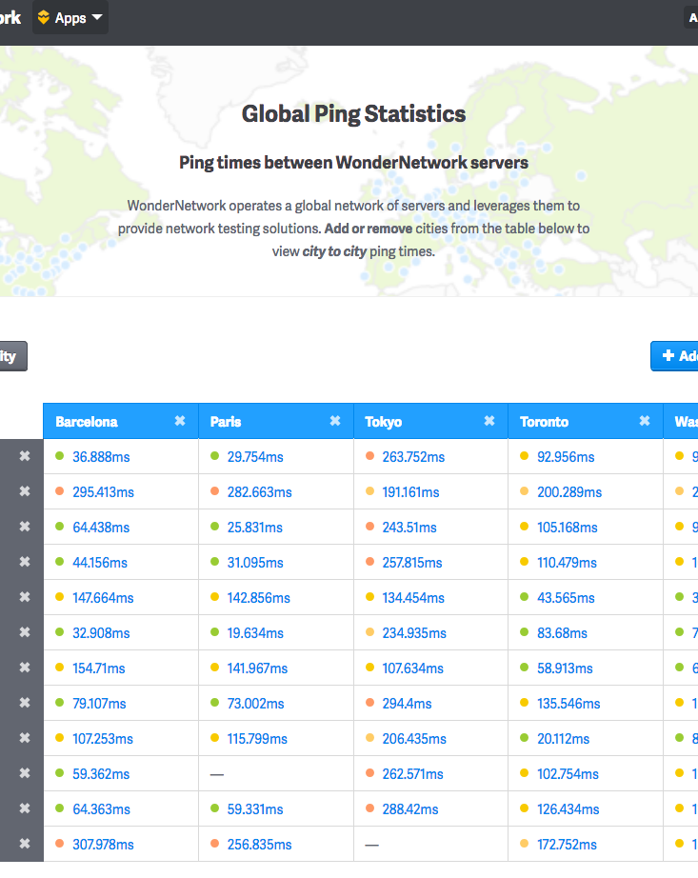
WAN Ping Latencies:
Source: https://wondernetwork.com/pings
Notes:
Should a discussion of world-wide network latencies come up, the Url above offers a neat tool.

Slide 36
Wikipedia.com: Tf-Idf Style Indexes
“Nowadays, Tf-Idf is one of the most popular term-weighting schemes; 83% of text-based recommender systems in the domain of digital libraries use tf-idf.
“Term frequency - the simplest choice is to use the raw count of a term in a document.
“Inverse document frequency - is a measure of how much information the word provides, that is, whether the term is common or rare across all documents. It is the inverse fraction of the documents that contain the word, obtained by dividing the total number of documents by the number of documents containing the term.
Source: https://en.wikipedia.org/wiki/Tf-idf
https://en.wikipedia.org/wiki/Bitmap_index
Notes:
Introductory detail on the topic of Tf-Idf style indexes, the index type central to DSE Search.

Slide 37
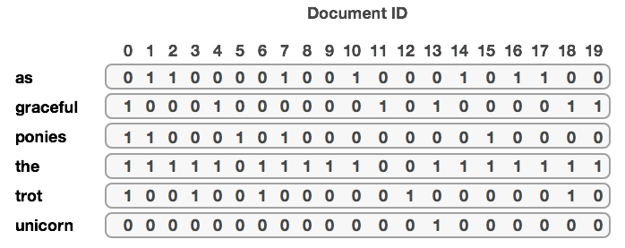
Tf-Idf (bitmap index) example-
The y-axis is populated with terms (tokens) extracted from a given column value.
The x-axis is the primary key to a given row.
1 represents true, zero false.
Which rows contain the value, “trot” ?
Which rows contain the values “trot” and “ponies” ?
Notes:
An example to facilitate discussion related to Tf-Idf (bitmap) style indexes.

Slide 38
Product Compatibility Matrix: DSE and Cassandra
Determining which version of DSE maps to which version of Cassandra-
Source: https://docs.datastax.com/en/landing_page/doc/landing_page/compatibility.html
Notes:
Source: https://docs.datastax.com/en/landing_page/doc/landing_page/compatibility.html

Slide 39
Performance: Mat.View versus Secondary Indexes
“The performance difference is dramatic even for small clusters, but even more important we see that indexed performance levels off when doubling from 8 to 16 nodes in the (AWS m3.xl) cluster, as the scatter/gather overhead starts to become significant.
Source: https://www.datastax.com/dev/blog/materialized-view-performance-in-cassandra-3-x
Notes:
Source: https://www.datastax.com/dev/blog/materialized-view-performance-in-cassandra-3-x

Slide 40
Solutions:
Notes:
Answers to the first Discussion Lab are on the next page-

Slide 41
Discussion Lab: (One) DSE Object Hierarchy
A:
Cluster
Keyspace
E == G + H
E:
F:
Table
Keyspace ==
Replication Strategy
B:
+ Replication Factor
Data center
J == K + M
C:
Rack
Partitioning Key
Primary Key ==
+ Clustering Column
E:
D:
F:
Node (host)
Table
Keyspace
Notes:
Solution to Discussion Lab-
Cluster and node are required. Everything else is optional just to boot.
Replication strategy: SimpleStrategy, NetworkTopologyStrategy, ( LocalStrategy : system keyspace, EverywhereStrategy : dse_system keyspace)
NetworkTopologyStrategy, multiple data centers
(Multiples):
Table is wholly contained within a keyspace
Keyspace can span data centers
A primary key can not span tables

